Slide 1
Fourty Five Days Industrial Training Project
Presentation
On
Banking System
Submitted To: Submitted By:
Ms. Bharti Vivek
8617114

Slide 2
Project Overview
Introduction Of Python
Features of python
Application Of python
Introduction of Project
Project Libraries
Data Flow Diagram
System Requirement
Test Plan
Screen Shot Of the Project
Limitation
Conclusion

Slide 3
Introduction Of Python
Python is general purpose programming language which can be used for a wide verity of applications.
It is used for:
web development (server-side),
software development,
mathematics,
system scripting,
machine learning.

Slide 4
Features of Python
Software Developer
Machine Learning (Ml)
Artificial Intelligence (AI)
Data Scientist
Data Analyst

Slide 5
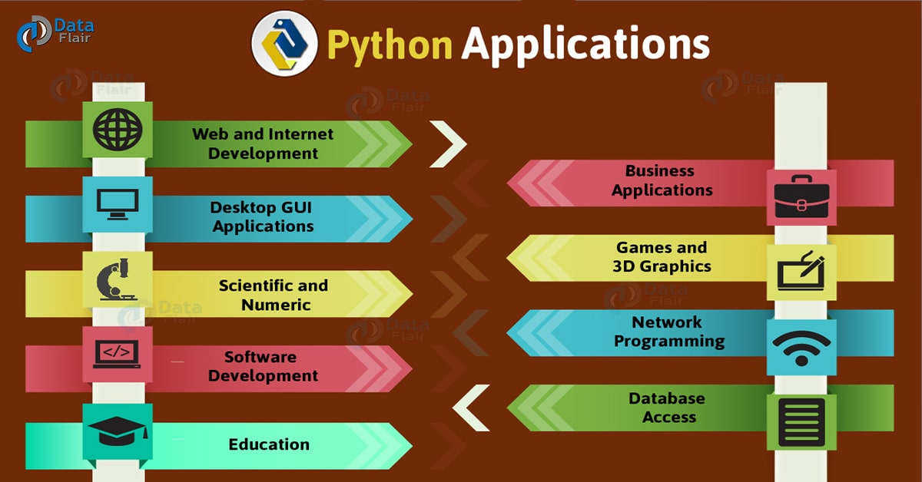
Application Of Python

Slide 6
Introduction Of Project
For this final project, we would like to implement a Banking system based on the Python system. We try to implement a simple banking system based on the basic usage .The main objectives of the project are to maintain price stability ; to support other objectives of the Government's economic policy, especially growth, employment, and reducing social gaps; and supporting the stability of the financial system.

Slide 7
Project Libraries
Basic Libraries
Time (preinstalled)
TkInter (preinstalled)

Slide 8
System Requirement
Hardware Requirement(Minimum Requirement):
i3 Processor Based Computer
4GB-RAM
120 GB Hard Disk
Software Requirement(Minimum Requirement):
Operating System
Pycharm
cmd

Slide 9
Test Plan
Tools for Implementation
PyCharm - Software development kit
TkInter – Project Interpreter

Slide 10
Screen Shot Of the Project

Slide 11
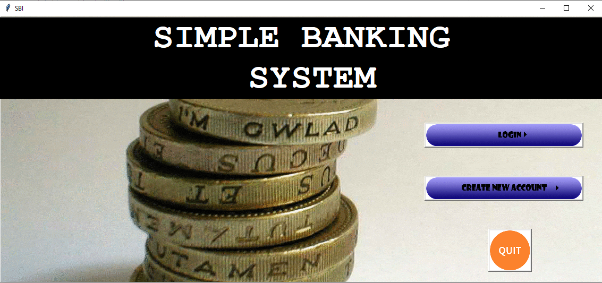

Slide 12
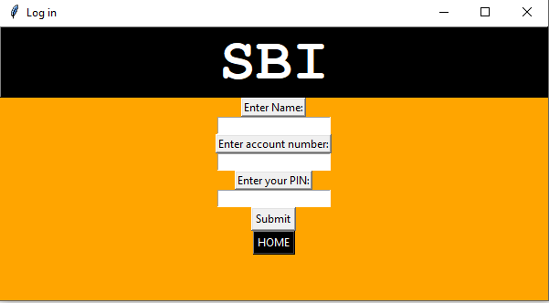

Slide 13
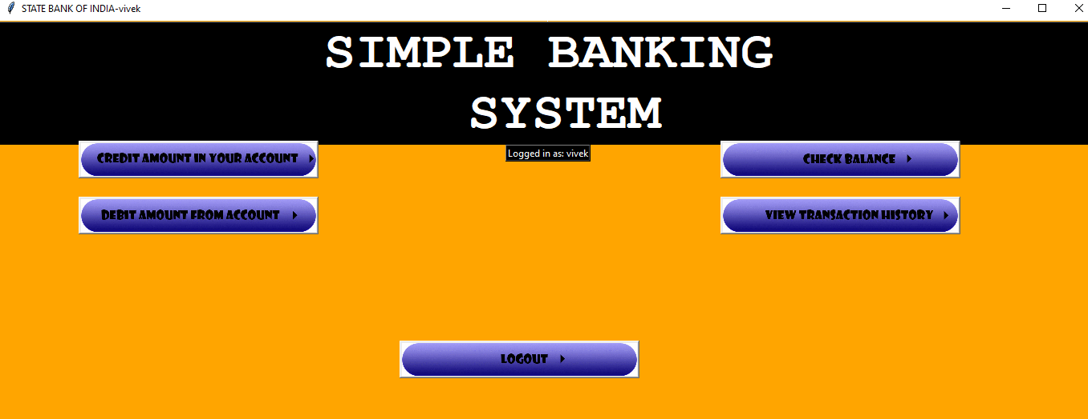

Slide 14
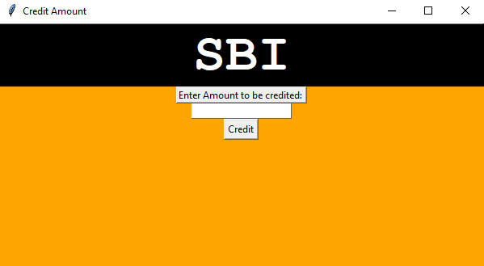

Slide 15
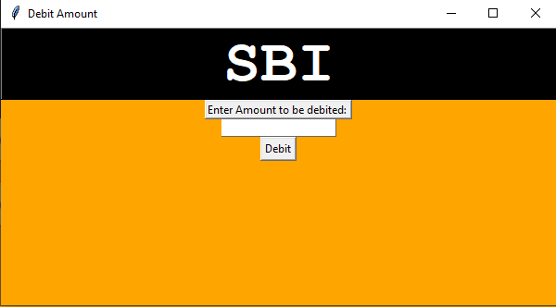

Slide 16
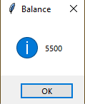

Slide 17
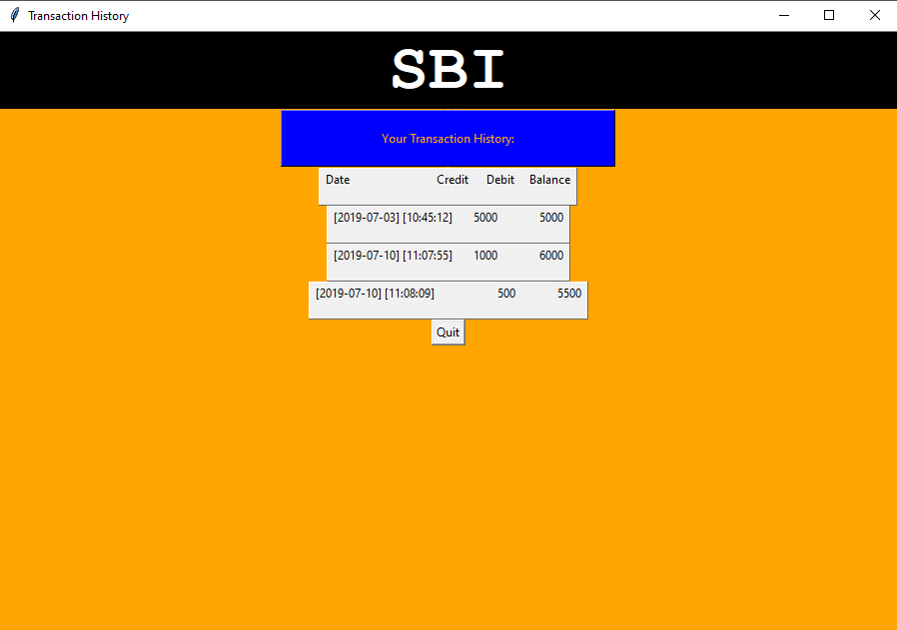

Slide 18
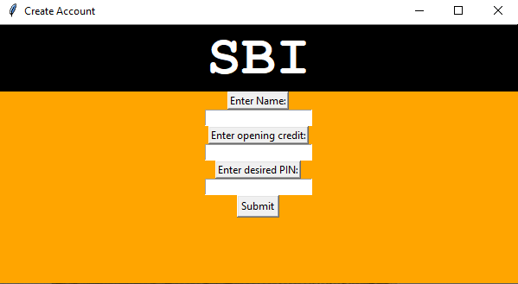

Slide 19
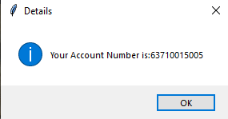

Slide 20


